Slide 1
First pages (2-5) are the wireframe

Slide 2
Liem Duong Media
Search bar
Liem Duong Media > Home
Property of Liem Duong LLC, Copyright ⓒ est. 2020
Navigation
Content of home page
Home
Professional
Personal
About
Contact
Shop
FAQ
*insert home page image that rotates through a set list of certain photos*
Property of Liem Duong LLC, Copyright ⓒ est. 2020

Slide 3
Liem Duong Media
Search bar
Liem Duong Media > About
Navigation
Liem Duong
Currently studying Business Information Systems in the School of Business at Virginia Commonwealth University
Hey, I’m Liem
I'm currently a student living in Richmond, Virginia. I have been photographing for about 8 years and
videographing for about 4. I’m well experienced in portrait and landscape photography and can curate short
video edits as well. I am well experienced in using Adobe Lightroom, Photoshop, and Premiere Pro. In
addition, I also plan on dabbling into film photography in the near future. I’m eager and always open to
shooting and exploring new ideas. My work is linked in the gallery tabs above. Though, If you would like
to follow my day to day work, follow my instagram at *Insert Instagram Handle* Thank you!
Home
Professional
Personal
About
Contact
Shop
FAQ
Property of Liem Duong LLC, Copyright ⓒ est. 2020

Slide 4
Liem Duong Media
Search bar
Liem Duong Media > Contact
Navigation
Contact Information
Business Email @liemduong123456789@email.com
Instagram @liemduong
Facebook @liemduong
Contact Directly through website
Name
Contact
Comments
Home
Professional
Personal
About
Contact
Shop
FAQ
Property of Liem Duong LLC, Copyright ⓒ est. 2020
Submit

Slide 5
Liem Duong Media
Search bar
Liem Duong Media > FAQ
Navigation
Frequently Asked Questions
Q1. What type of work do you provide, what do you do, etc…
A1. I am a photographer and branching out into videography
Q2. What camera and equipment do you use?
A2. I use the honda civic 9000
Etc…
Home
Professional
Personal
About
Contact
Shop
FAQ
Property of Liem Duong LLC, Copyright ⓒ est. 2020

Slide 6
Last Pages (7-10) display the prototype of the website
The look and feel of the pages of the site

Slide 7
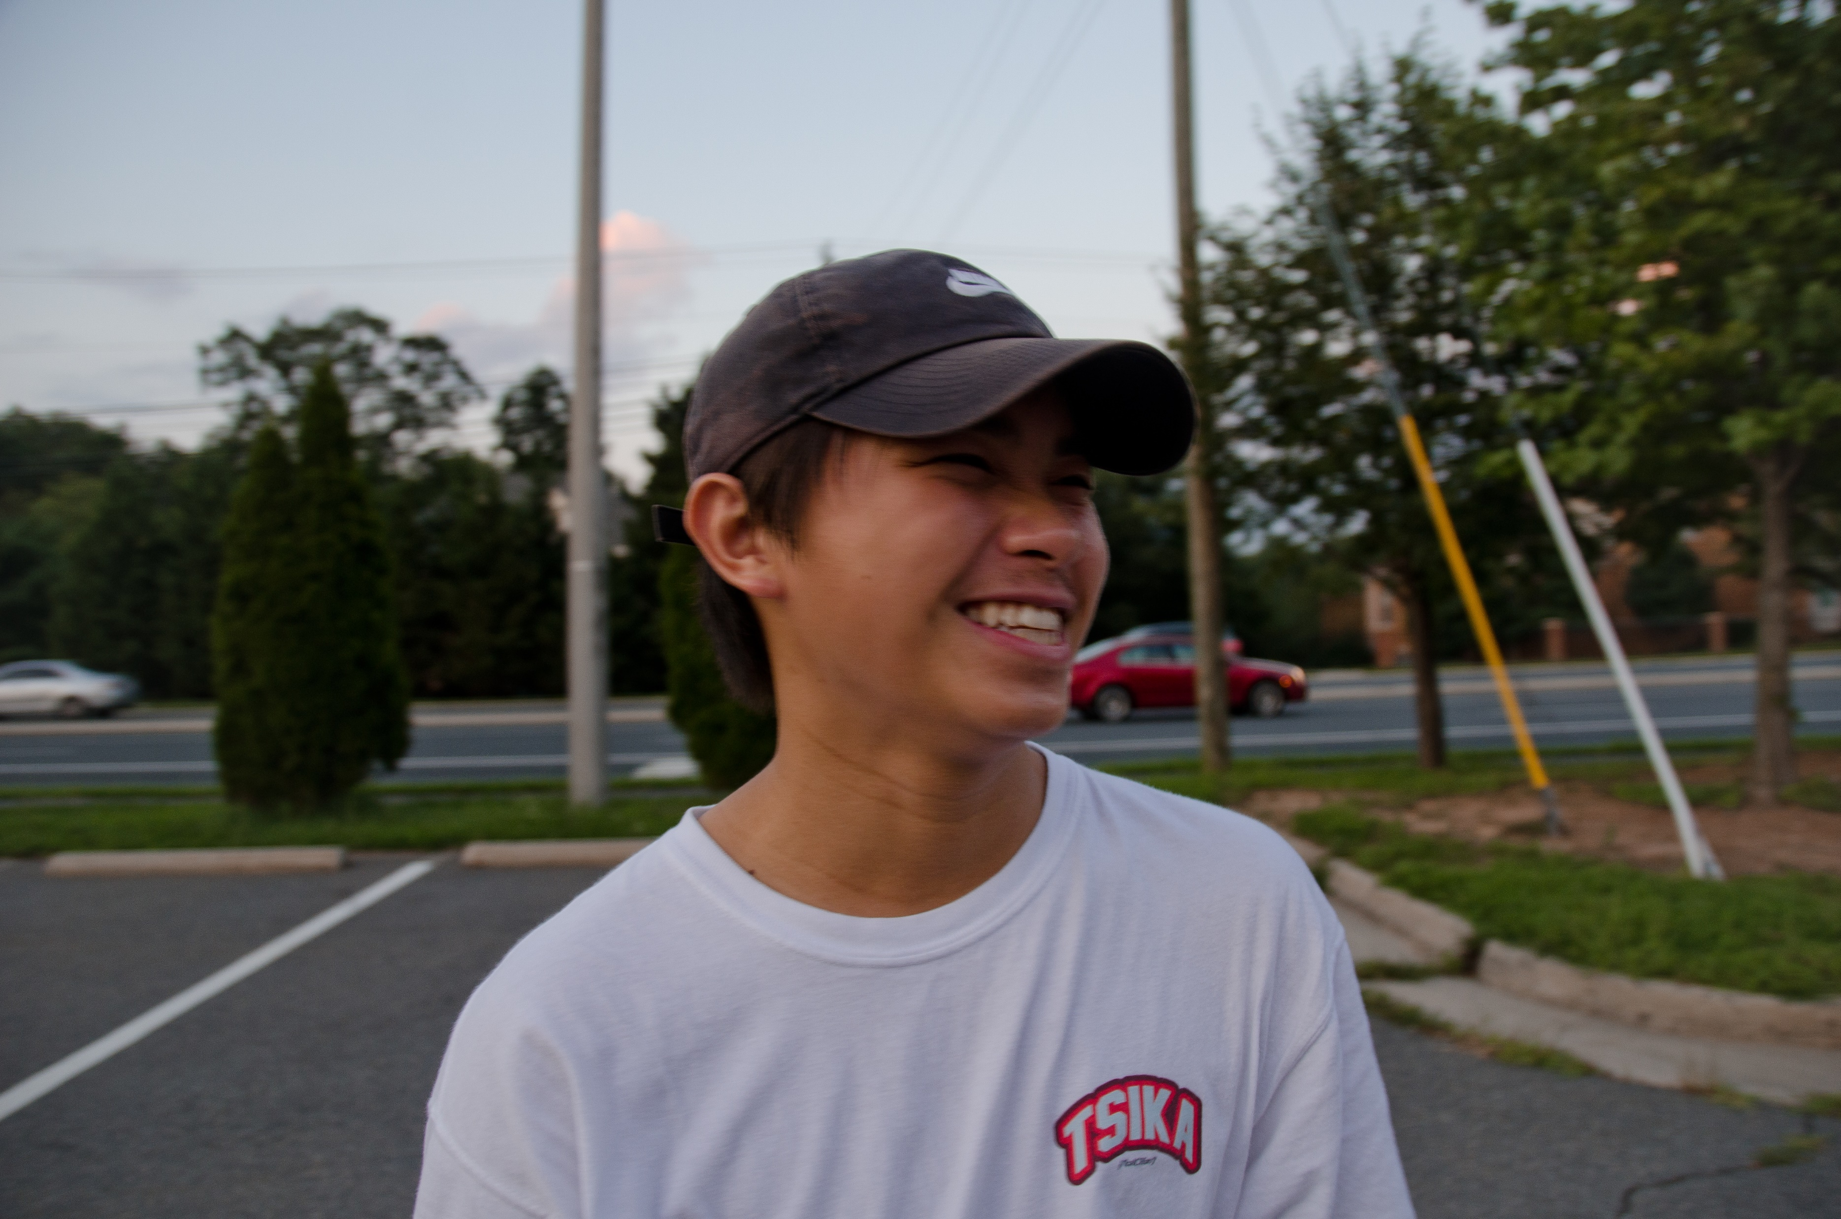
Liem Duong Media
Search: ___________________________________
Liem Duong Media > Home
Navigation
Home
Professional
Personal
About
Contact
Shop
FAQ
Property of Liem Duong LLC, Copyright ⓒ est. 2020

Slide 8
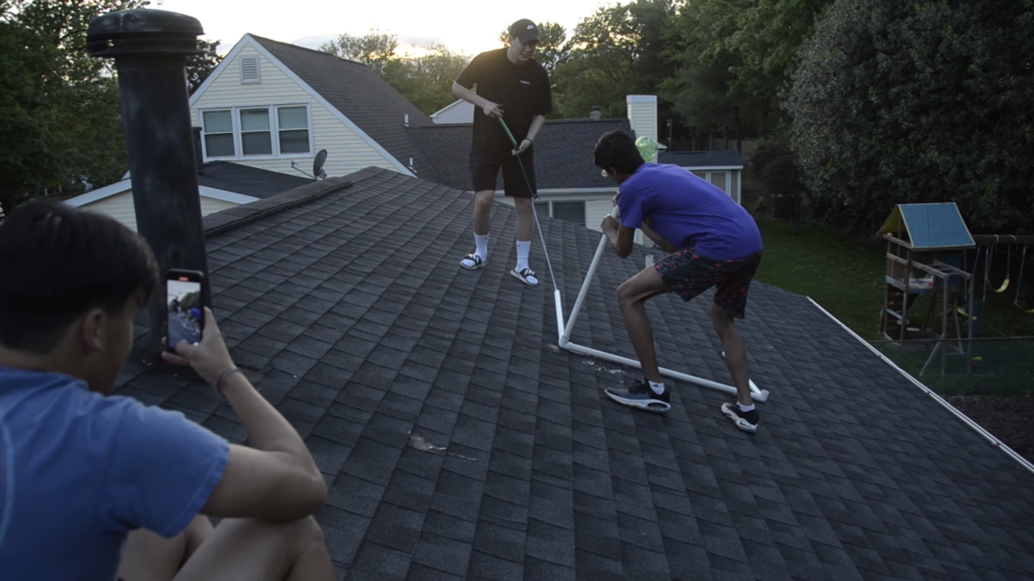
Liem Duong Media
Search: ___________________________________
Liem Duong Media > About
Navigation
Home
Professional
Personal
About
Contact
Shop
FAQ
Currently studying Business Information Systems in the School of Business at Virginia Commonwealth University
Hey, I’m Liem
I'm currently a student living in Richmond, Virginia. I have been photographing for about 8 years and video graphing for about 4. I’m well experienced in portrait and landscape photography and can curate short video edits as well. I am well experienced in using Adobe Lightroom, Photoshop, and Premiere Pro. In addition, I also plan on dabbling into film photography in the near future. I’m eager and always open to shooting and exploring new ideas. My work is linked in the gallery tabs above. Though, If you would like to follow my day-to-day work, follow my Instagram at *Insert Instagram Handle* Thank you!
Property of Liem Duong LLC, Copyright ⓒ est. 2020

Slide 9
Liem Duong Media
Search: ___________________________________
Liem Duong Media > About
Navigation
Contact Me
If you have any questions relating media inquires, availability, or just life, please feel free to contact me here on this website @liemduongbusiness@email.com
Contact Directly through website
Name
Contact
Comments
Follow me on my other social @:
Instagram @liemduong
Facebook @liemduong
Home
Professional
Personal
About
Contact
Shop
FAQ
Submit
Property of Liem Duong LLC, Copyright ⓒ est. 2020

Slide 10
Liem Duong Media
Search: ___________________________________
Liem Duong Media > About
Navigation
Frequently Asked Questions
What type of work do you provide, what do you do, etc…
I am a photographer and branching out into videography
What camera and equipment do you use?
I use the honda civic 9000
Etc…
Home
Professional
Personal
About
Contact
Shop
FAQ
Property of Liem Duong LLC, Copyright ⓒ est. 2020

